Slide 1
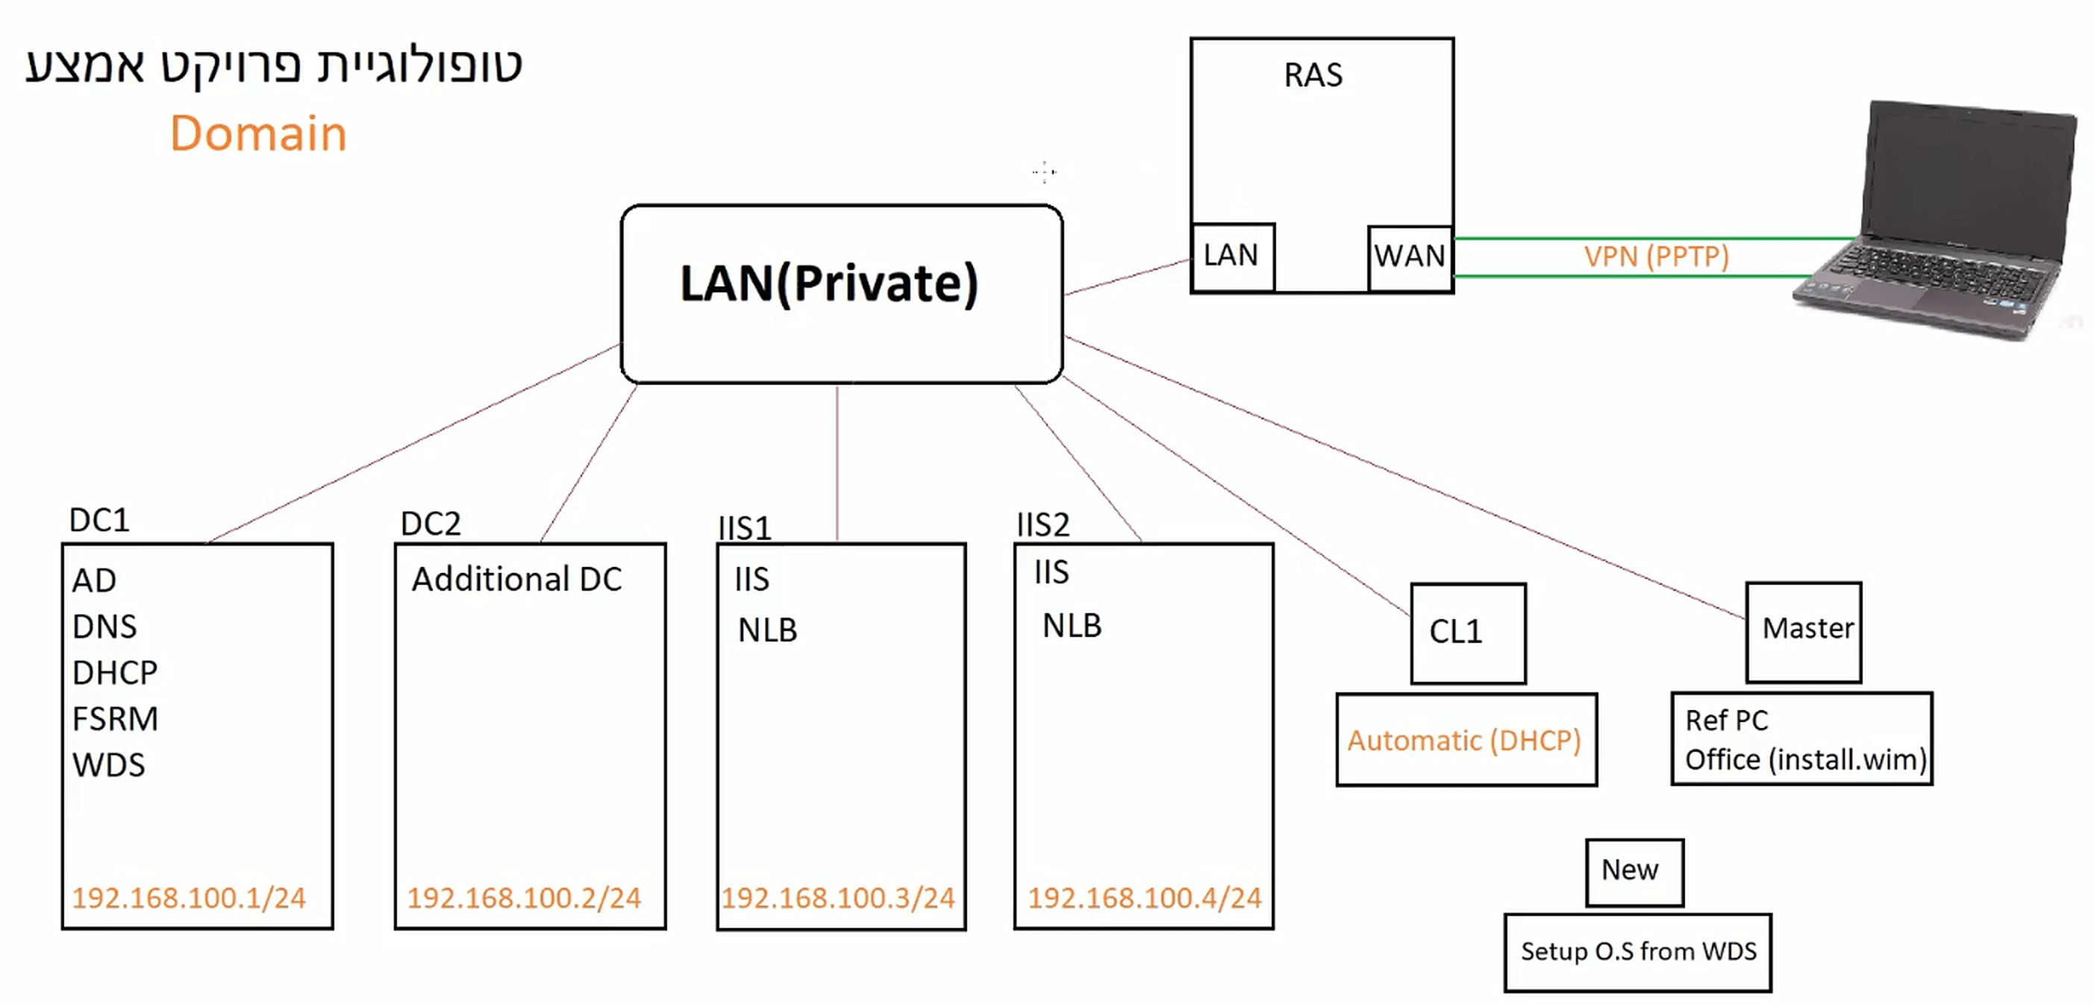
BEN.LOCAL
PROJECT SUMMARY
BY BEN HALEVY

Slide 2
BEN.LOCAL
PROJECT SUMMARY
A 111-slide build of a complete Windows Server Active Directory domain in Hyper-V
6 Organizational Units, 9 virtual machines, 2 networks (LAN / WAN)
From the first virtual switch to mass deployment of Windows 10
Identity, Group Policy, storage, remote access, high availability, deployment
What was built, why, and how it can be used

Slide 3
Mission Parameters
ORGANIZATIONAL INFRASTRUCTURE
WHAT THE PRESENTATION BUILDS
A complete Active Directory domain : BEN.LOCAL (Lev Hagalil home office)
6 OUs : Management, Office, Finance, Sales, Architects, IT
LAN 192.168.100.0/24 and WAN 192.168.200.0/24 in Hyper-V
9 virtual machines : DC1, DC2, RAS, IS1, IS2, CL1, PC1, Master, NEW
THREE SECTIONS
Organizational Infrastructure (slides 3 - 54) : domain, users, delegation, Group Policy, file services, FSRM
Network Infrastructure (slides 55 - 95) : VPN, second DC, printers, DNS, IIS + NLB, iSCSI, WDS
Image Deployment (slides 96 - 110) : Sysprep, DISM capture and servicing, WDS import, PXE deployment
Build Map (slide 111) : every machine, IP address and role on one slide

Slide 4
Mission Parameters
ORGANIZATIONAL INFRASTRUCTURE
PURPOSE
Built as a Mid Term Project
Now a portfolio piece : end-to-end Windows Server administration
Every task : the requirement, the exact steps, the screenshots
WHAT IT SHOWS
The full lifecycle : infrastructure, identity, policy, storage, remote access, high availability, deployment
Each task builds on the one before it - the network grows from one switch into a complete organization
Real troubleshooting : FSRM file screens broke GPO editing on Server 2019 - fixed with fltmc unload / load datascrn
Slides 96 - 110 : commands and click-paths from Microsoft documentation, no lab screenshots - all earlier slides show lab work

Slide 5
Mission Parameters
ORGANIZATIONAL INFRASTRUCTURE
SKILLS DEMONSTRATED - IDENTITY & POLICY
Active Directory Domain Services : forest, OUs, users, groups
PowerShell scripting for bulk OU and user creation
Delegation of control and fine-grained password policy (PSO)
Group Policy : password, lockout, restricted groups, redirection
SKILLS DEMONSTRATED - SERVICES, NETWORK & DEPLOYMENT
DHCP and DNS (scope, forwarders, root hints) - File services, NTFS share permissions, drive mapping, item-level targeting
FSRM quotas and file screens - Shadow copies - Software and file deployment through GPO - Printer deployment through GPO
Routing and Remote Access : VPN (PPTP) with network policy - Second domain controller and FSMO (RID master) transfer
IIS web servers in a Network Load Balancing cluster - iSCSI target / initiator with a spanned volume
Windows Deployment Services, PXE boot, Sysprep and DISM image capture, servicing and deployment

Slide 6
Mission Parameters
ORGANIZATIONAL INFRASTRUCTURE
SLIDE MAP - ORGANIZATIONAL INFRASTRUCTURE (1 - 25)
Slides 1 - 2 : Title and organizational requirements
Slide 3 : Private virtual switch LAN
Slides 4 - 5 : DC1, AD DS forest BEN.LOCAL, DHCP scope
Slide 6 : Client CL1 joined to the domain
Slides 7 - 9 : OUs and user accounts created with PowerShell scripts
Slides 10 - 11 : Delegation - Adam resets Sales passwords
Slides 12 - 15 : Domain password and lockout policy, password relief (PSO)
Slides 16 - 17 : Home folders mapped to Z:
Slides 18 - 21 : HelpDesk security group through Restricted Groups
Slides 22 - 25 : Folder redirection to \\DC1\Home, DHCP check

Slide 7
Mission Parameters
ORGANIZATIONAL INFRASTRUCTURE
SLIDE MAP - ORGANIZATIONAL INFRASTRUCTURE (26 - 54)
Slides 26 - 28 : Removable storage blocked for Sales
Slides 29 - 32 : Calc.exe blocked for Office
Slides 33 - 36 : Reports share Y: with group permissions
Slides 37 - 41 : FSRM quotas (2GB / 3GB) and file screens
Slides 42 - 44 : Shadow copies for previous versions
Slides 45 - 48 : Desktop file by GPO, FSRM / GPO bug workaround
Slides 49 - 50 : Control Panel and CMD blocked for Finance
Slides 51 - 52 : Software deployment by GPO (7-Zip)
Slides 53 - 54 : Item-level targeted drive map S:

Slide 8
Mission Parameters
NETWORK INFRASTRUCTURE
SLIDE MAP - NETWORK INFRASTRUCTURE & IMAGE DEPLOYMENT (55 - 111)
Slides 55 - 57 : RAS server, WAN network and remote client PC1
Slides 58 - 63 : VPN server (PPTP) for the Management group
Slides 64 - 66 : DC2 and RID pool manager transfer
Slides 67 - 82 : Printer 1 and Printer 2 shared and mapped by GPO
Slides 83 - 84 : DNS forwarders and root hints
Slides 85 - 89 : IIS web servers and NLB cluster (www.site.com)
Slides 90 - 92 : iSCSI target and initiator, spanned volume E:
Slides 93 - 95 : WDS and PXE boot for VM NEW
Slide 96 : Image Deployment overview
Slides 97 - 110 : Seven steps - Master, Sysprep, WDS, DISM capture, DISM servicing, WDS import, PXE deploy
Slide 111 : Build Map

Slide 9
Mission Parameters
NETWORK INFRASTRUCTURE
BEN.LOCAL - BUILD MAP
DC1 - Windows Server 2019 (4Gb Ram) (40Gb HD) - 192.168.100.1 - AD DS, DNS, DHCP, WDS, FSRM, File & Print Server
DC2 - Additional Domain Controller (2Gb Ram) (40Gb HD) - 192.168.100.2 - RID Pool Manager, iSCSI Initiator (Drive E:)
RAS - Windows Server 2016 (2Gb Ram) (40Gb HD) - LAN 192.168.100.254 / WAN 192.168.200.1 - VPN (PPTP) + iSCSI Target
IS1 / IS2 - (2Gb Ram) (30Gb HD) - 192.168.100.3 / 192.168.100.4 - IIS Web Servers, NLB Cluster 192.168.100.10
Print1 / Print2 - 192.168.100.50 / 192.168.100.51 - Finance & Office / Sales & Architects (deployed by GPO)
CL1 - Windows 10 Pro (2Gb Ram) (40Gb HD) - DHCP - Domain client in the IT OU
PC1 - Windows 10 (1Gb Ram) (30Gb HD) - 192.168.200.10 (WAN) - VPN client to RAS
Master / NEW - Windows 10 Pro - DHCP (PXE) - Golden Image reference / PXE deployment target

Slide 10
Mission Parameters
NETWORK INFRASTRUCTURE
HOW IT CAN BE USED
Portfolio evidence of hands-on Windows Server work
Interview walkthrough - one Task / How To pair at a time
Rebuild guide and training material for new administrators
IN PRACTICE
Portfolio : shown on the website as proof of Active Directory, Group Policy, networking and deployment work
Interview : each Task / How To pair is talked through in a few minutes with the screenshots as proof
Rebuild : the How To rows are click-paths and commands in order - the lab can be rebuilt from scratch in Hyper-V
Training : each slide pair works as a lesson for students learning Windows Server administration
Reference : the slide map and build map locate any task, machine or IP address quickly

Slide 11
Mission Parameters
NETWORK INFRASTRUCTURE
SOURCES - IMAGE DEPLOYMENT COMMANDS (Microsoft Learn, click to open)
Microsoft Learn - Sysprep (Generalize) a Windows installation
Microsoft Learn - Sysprep command-line options
Microsoft Learn - Capture images of hard disk partitions using DISM
Microsoft Learn - DISM image management command-line options
Microsoft Learn - DISM operating system package servicing options
Microsoft Learn - Add and remove drivers to an offline Windows image
Microsoft Learn - OEM deployment of Windows desktop editions (Audit Mode)
Microsoft Learn - wdsutil /Set-Server
Microsoft Learn - wdsutil /New-CaptureImage
Microsoft Learn - Create a Custom Install Image (WDS)
Microsoft Learn - Import-WdsInstallImage
Microsoft Learn - New-WdsInstallImageGroup

